Slide 1
Aspect and service oriented
Presented by :
Abdulrahman Saeed 18P8700
Mohammed Mamdouh 18P8906
Abdelrahman Tarek 18P7159
Salma Osama Mohamed 18P5097

Slide 2
Introduction
GAME HIVE is a web-based application that allows users to buy and sell products related to gaming. The system is designed to provide a platform where gamers can connect with each other and trade gaming products securely.

Slide 3
Project Motivation
Gaming is a massive industry that has continued to grow over the years. The gaming industry generated over $150 billion in revenue, making it one of the most lucrative industries globally.
Gaming is a growing industry with a vast potential for growth.
Entrepreneurs looking to tap into the growing gaming industry can benefit greatly from developing such projects.

Slide 4
Services and Aspects

Slide 5
Consumed Services
Credit Card Service
Email Service
Product Service
Confirmation Token Service
Password Encoder Service
User Service

Slide 6
Provided Services
Registration Service
Application User Service

Slide 7
Aspects
Logging
Security

Slide 8
Project Overview

Slide 9

Application Properties & POM.xml
Project Structure
Database
Website Pages

Slide 10
Properties & POM
Application Properties
Pom.xml

Slide 11
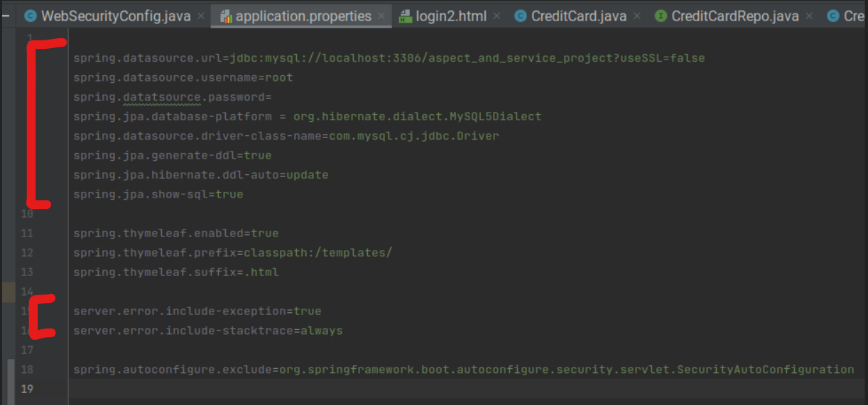
Application Properties

Slide 12
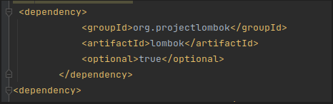
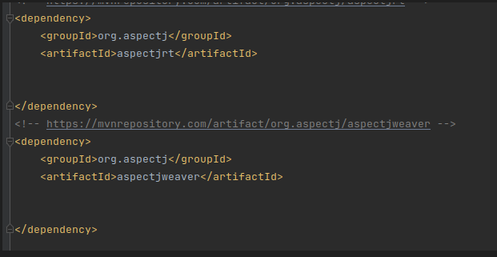
POM.XML

Slide 13
Project Structure
Packages
Resources Folder
Static
Templates

Slide 14
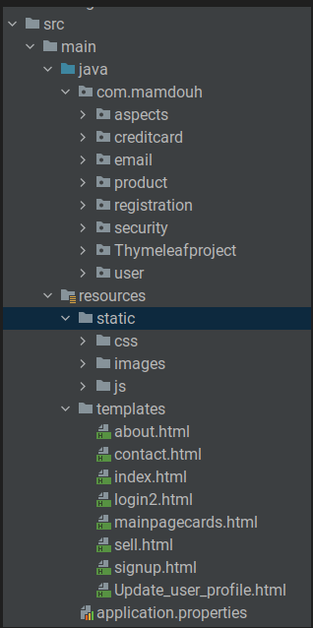


Slide 15
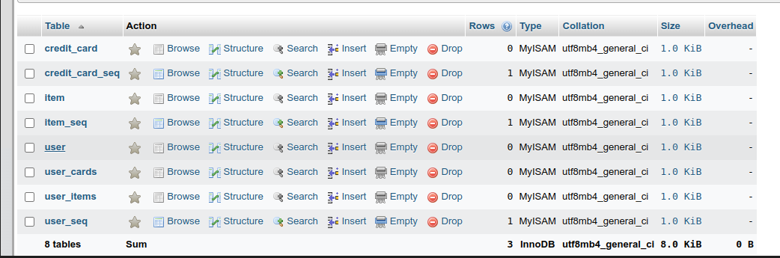
Database

Slide 16

To Show Database Attributes

Slide 17
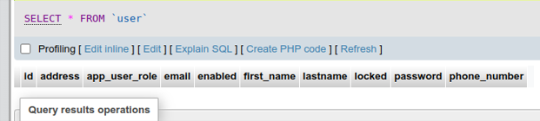
User Database

Slide 18
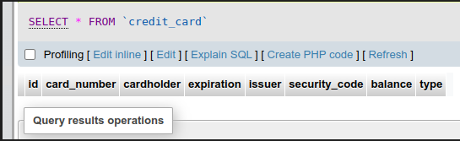
Credit Card Database

Slide 19
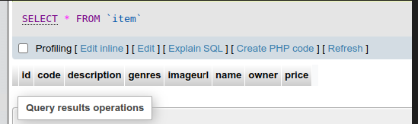
Item Database

Slide 20
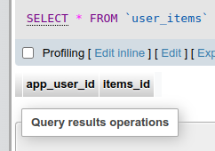
User & Items Connecter

Slide 21
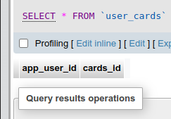
User & Card Conector

Slide 22
Pages

Slide 23
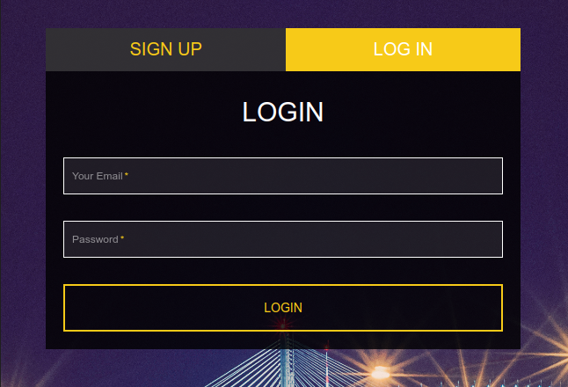
Login

Slide 24
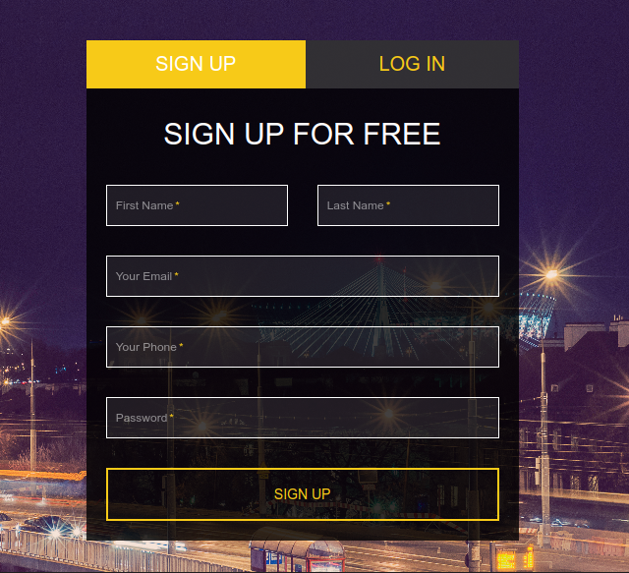
Sign Up

Slide 25
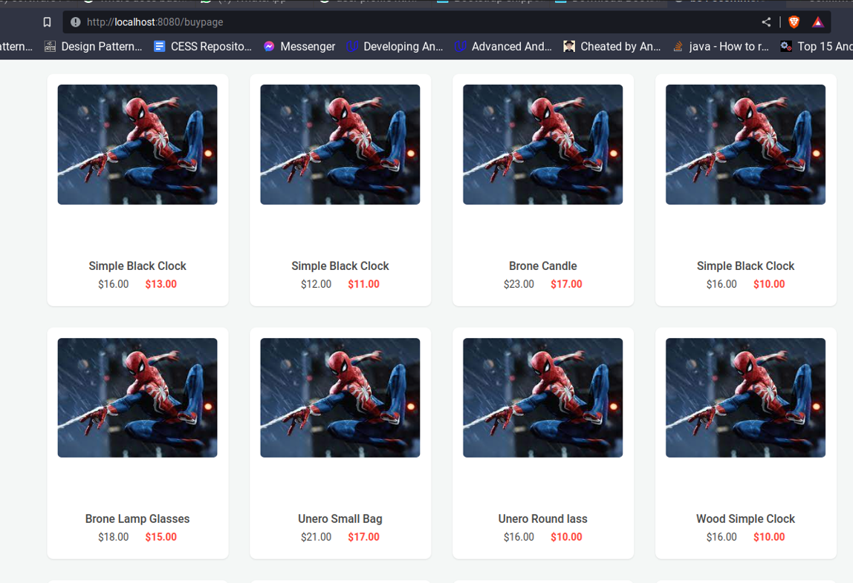
Shopping

Slide 26
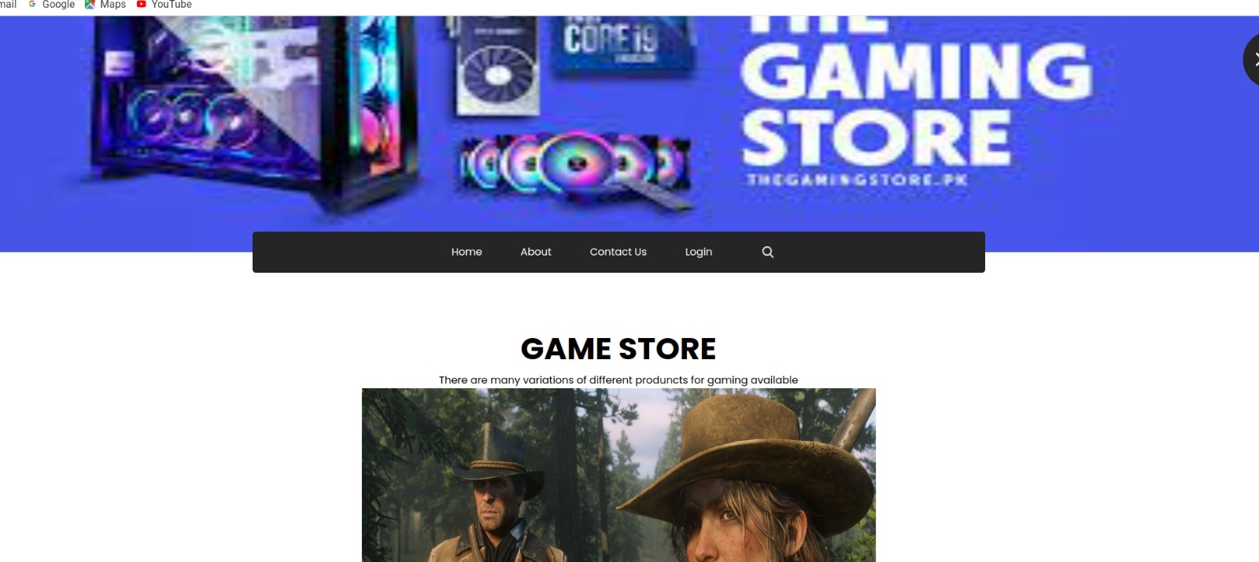
Index Page

Slide 27
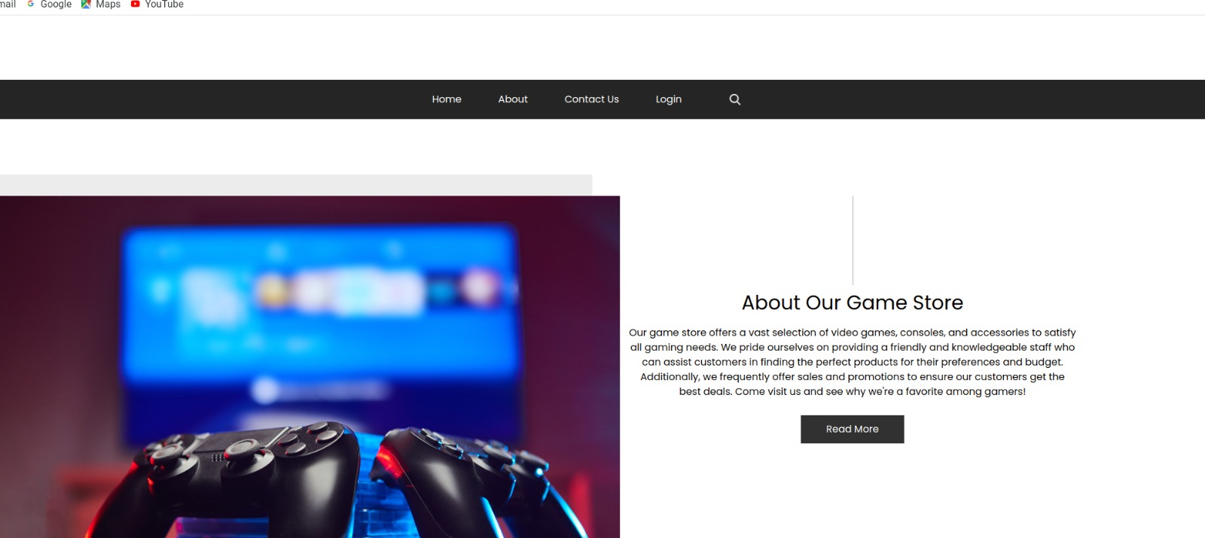
About Us Page

Slide 28
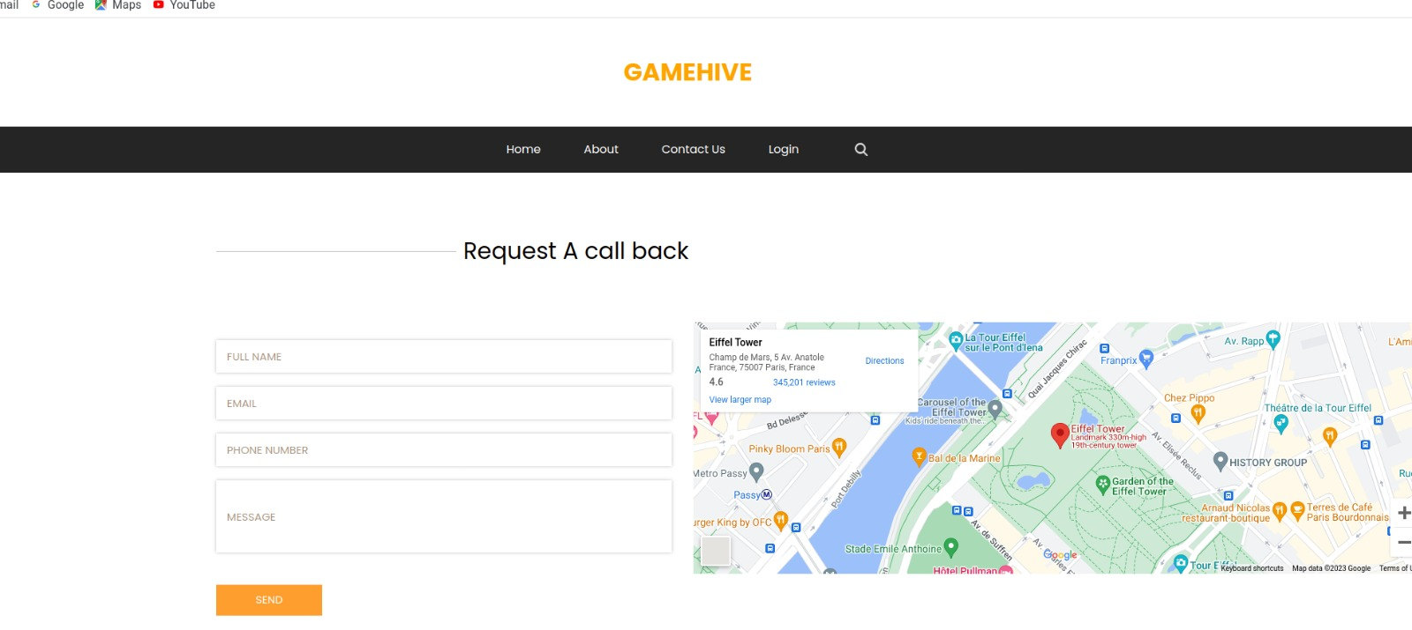
Contact Us Page

Slide 29
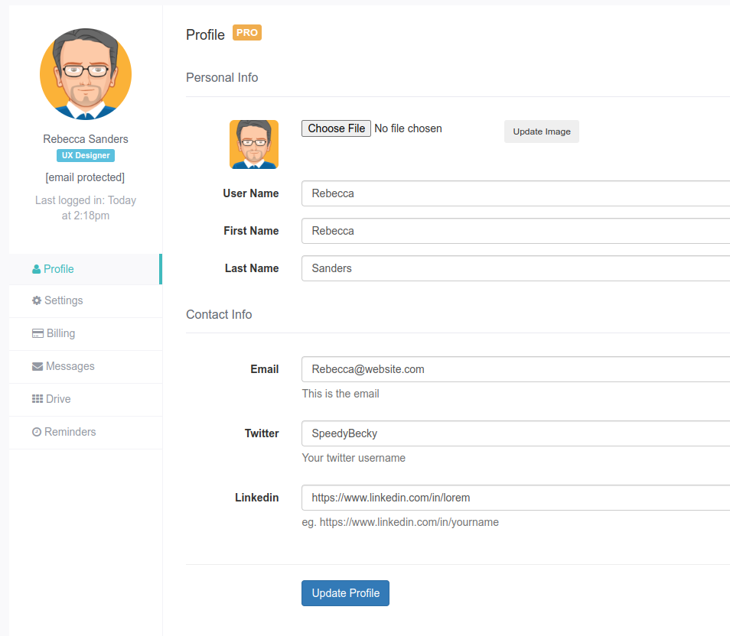
Update Profile

Slide 30
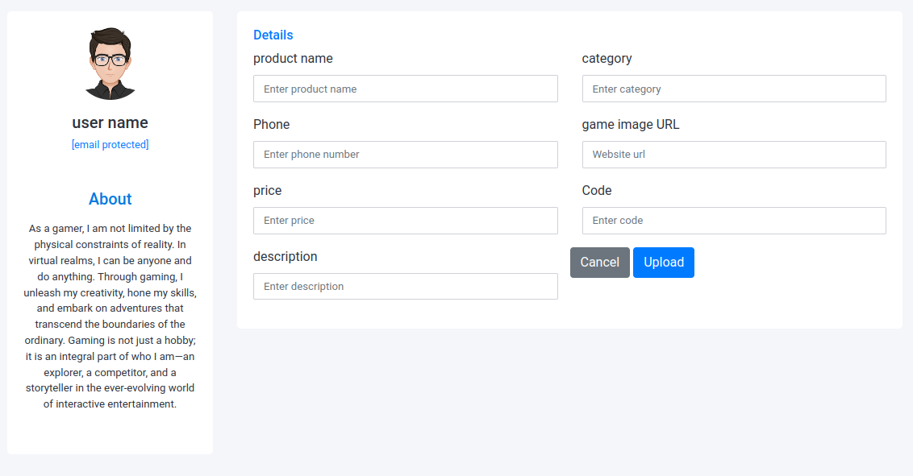
Upload Item

Slide 31
ASPECTS AND USER SERVICE

Slide 32
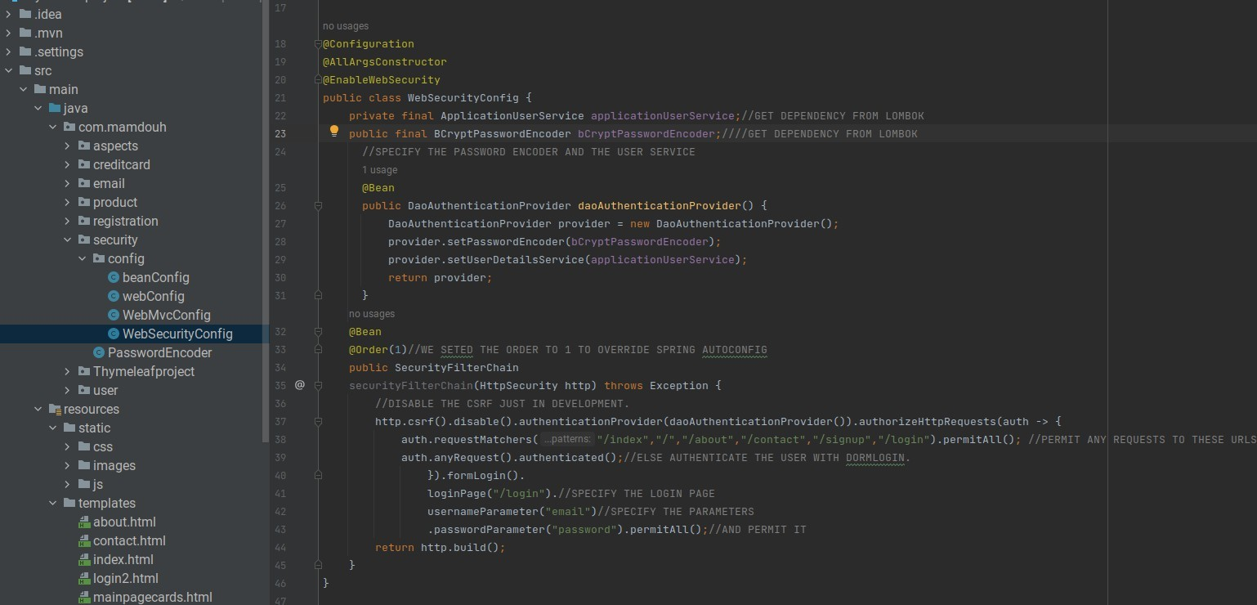
Security Aspect and configuration

Slide 33
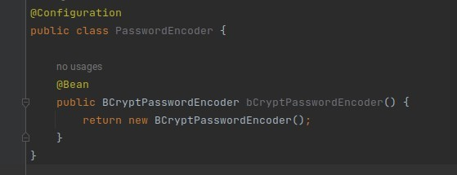
Password Encoder
BCrypt is a one-way salted hash function based on the Blowfish cipher.

Slide 34
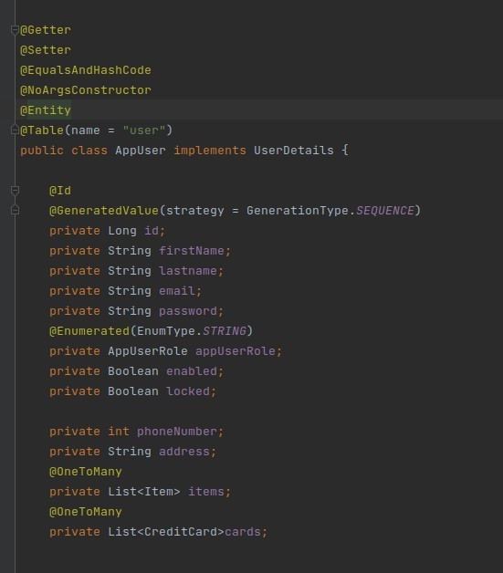
Application User
Implementations are not used directly by Spring Security for security purposes. They simply store user information which is later encapsulated into Authentication objects.

Slide 35
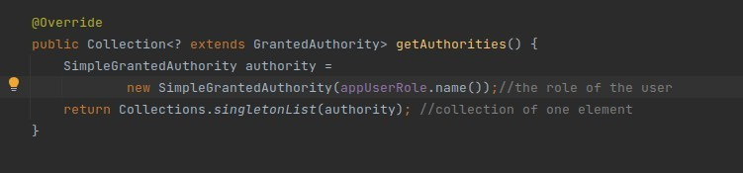
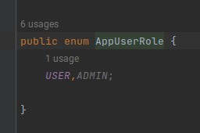
Role

Slide 36
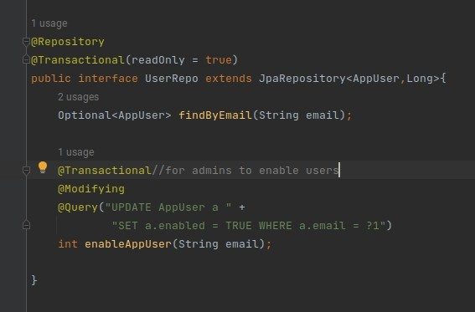
Repository

Slide 37
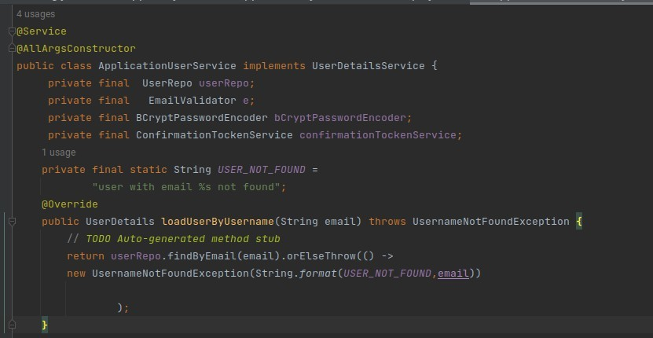
Application user service
Core interface which loads user-specific data.
Used by DauAuthentication- Provider

Slide 38
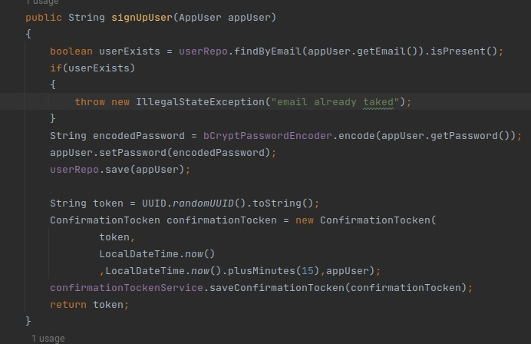
Sign-up User
Check if user exists
Encode the password
Save user
Return confirmation token

Slide 39
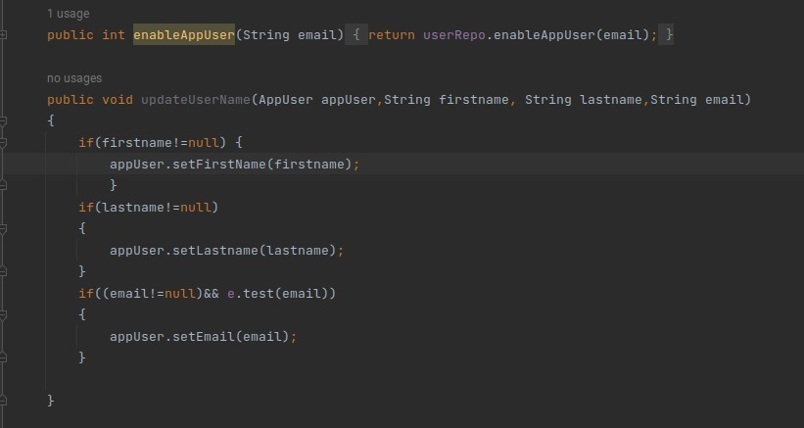
Update User Account

Slide 40
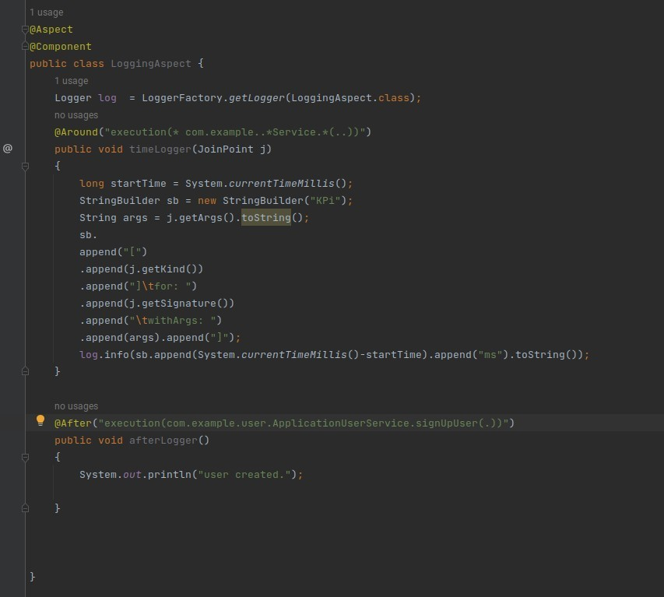
Logger Aspect
The afterLogger() method logs a message indicating the creation of a user.
It intercepts method executions for classes under the com.example package ending with "Service".

Slide 41
Registration and Token Services

Slide 42
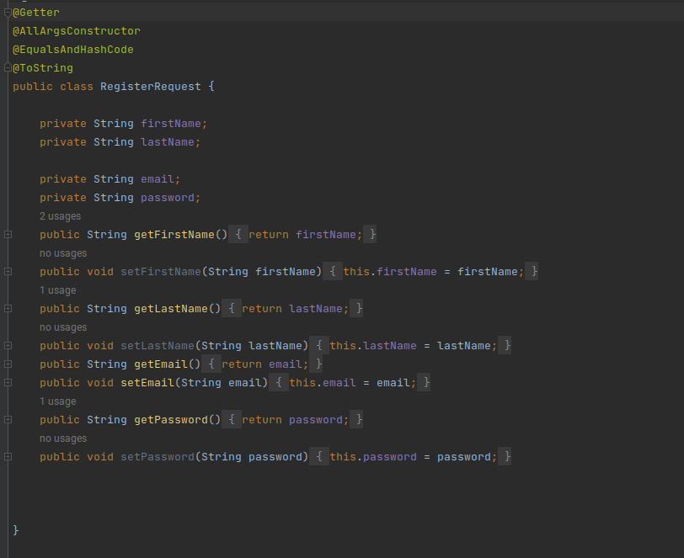
Registration Request

Slide 43
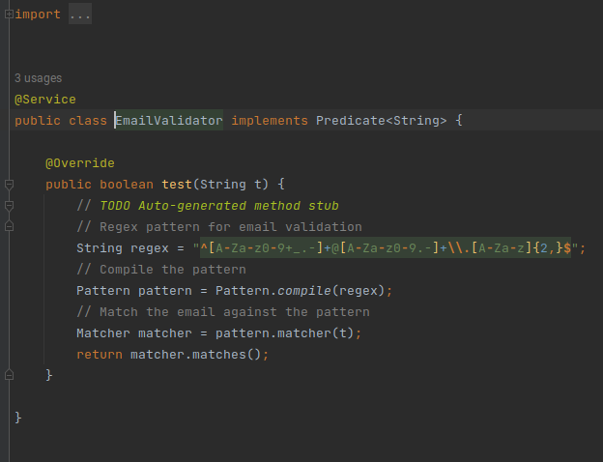
Email Validator

Slide 44
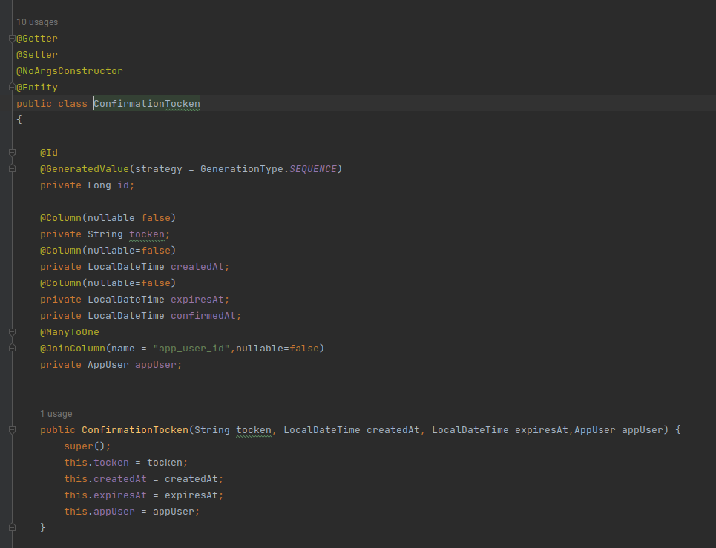
Confirmation Token

Slide 45
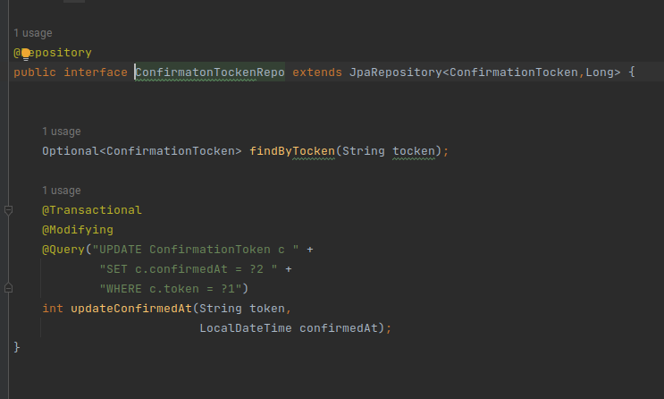
Confirmation Token Repo

Slide 46
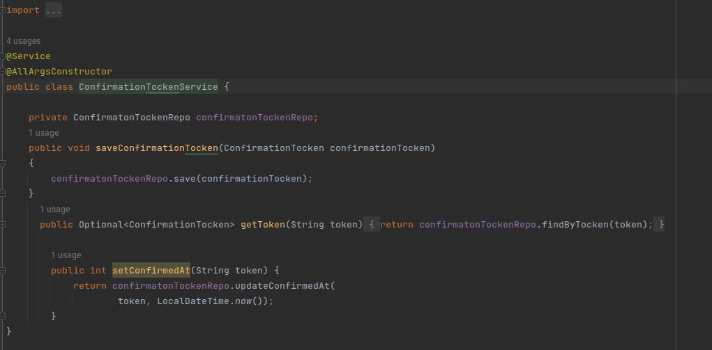
Token Service

Slide 47
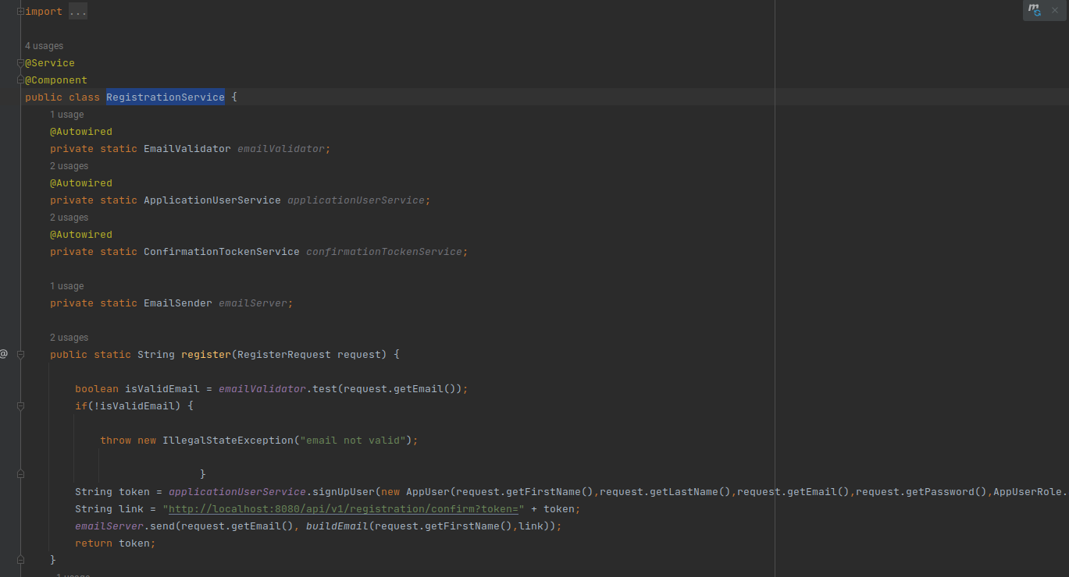
Registration Service

Slide 48
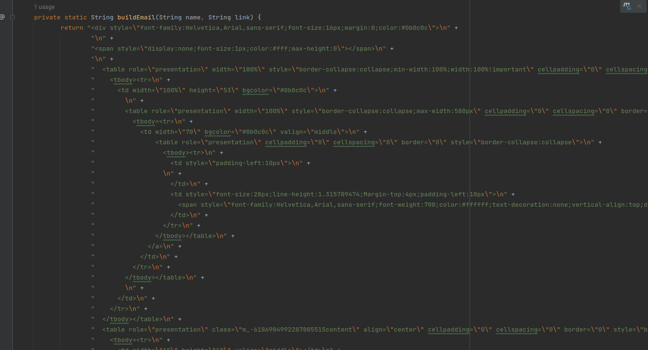
Registration Service

Slide 49
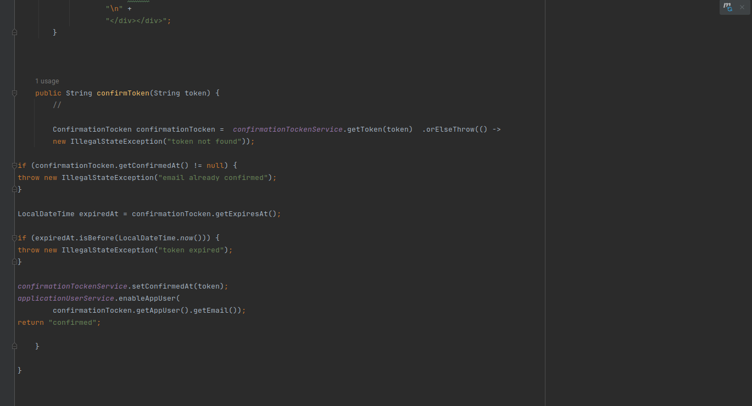
Registration Service

Slide 50
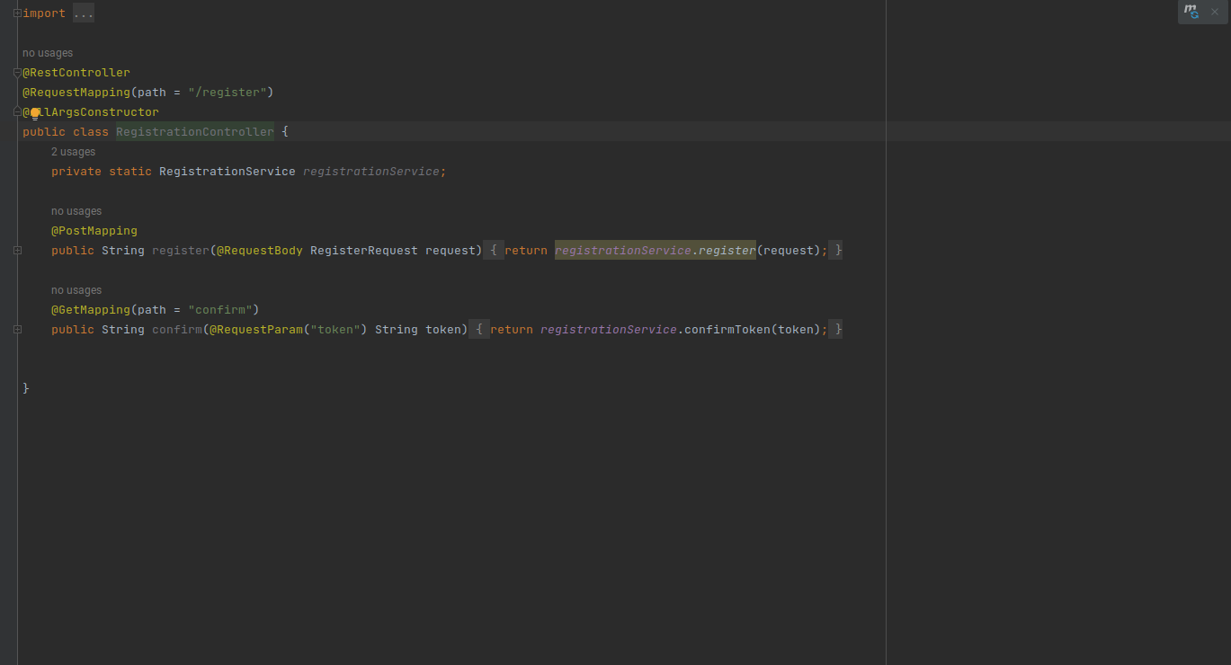
Registration Controller

Slide 51
Product ,Email and Credit Card

Slide 52
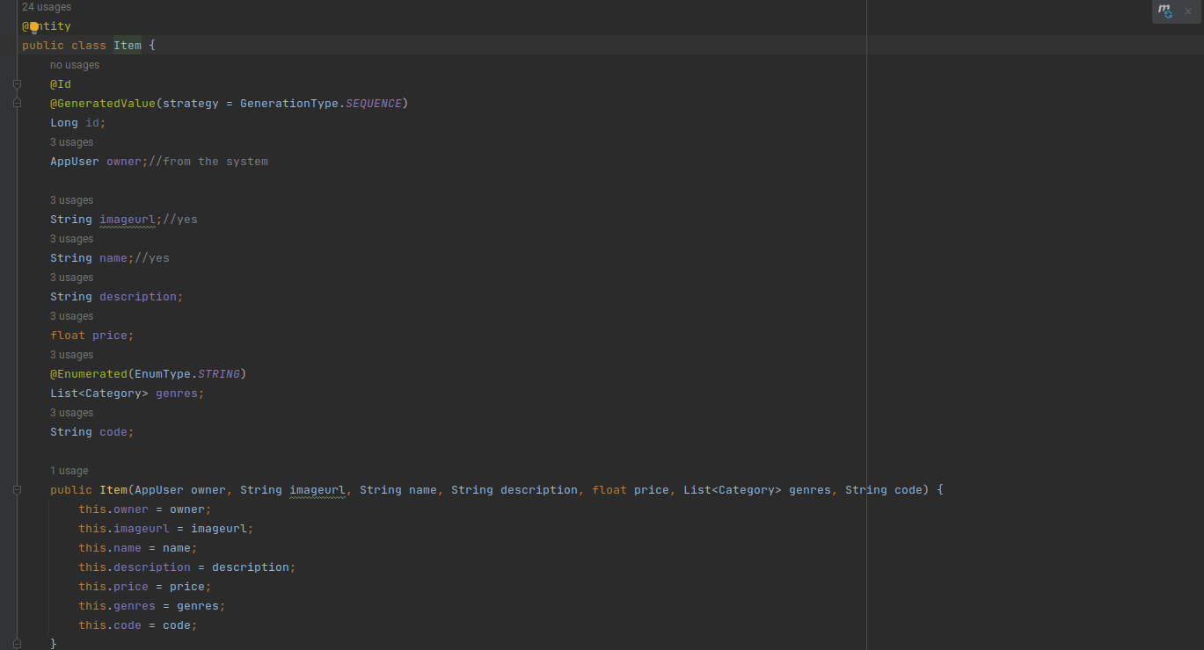
Product Item-Entity

Slide 53
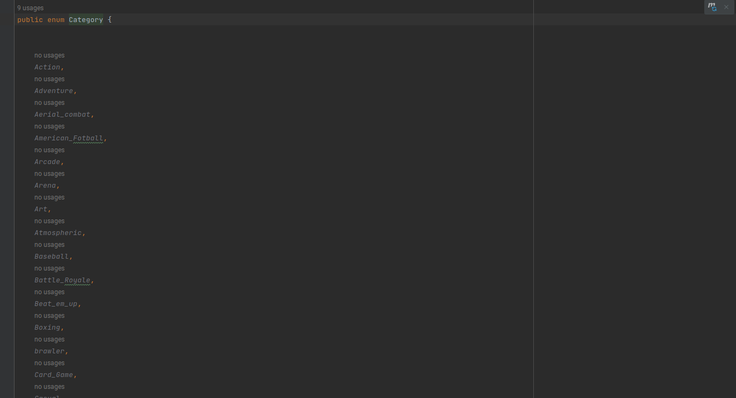
Categories

Slide 54
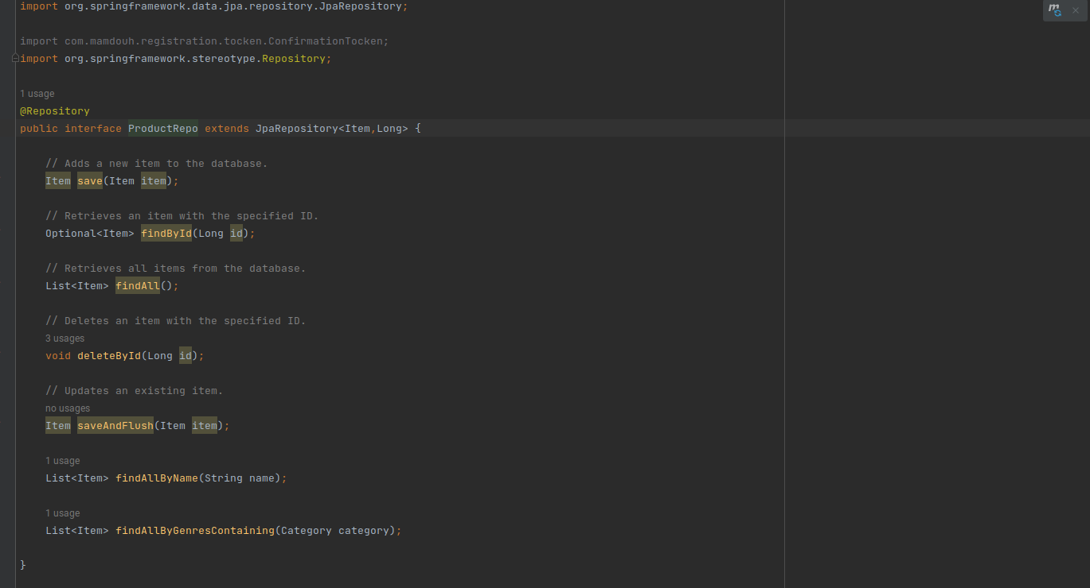
Repo

Slide 55
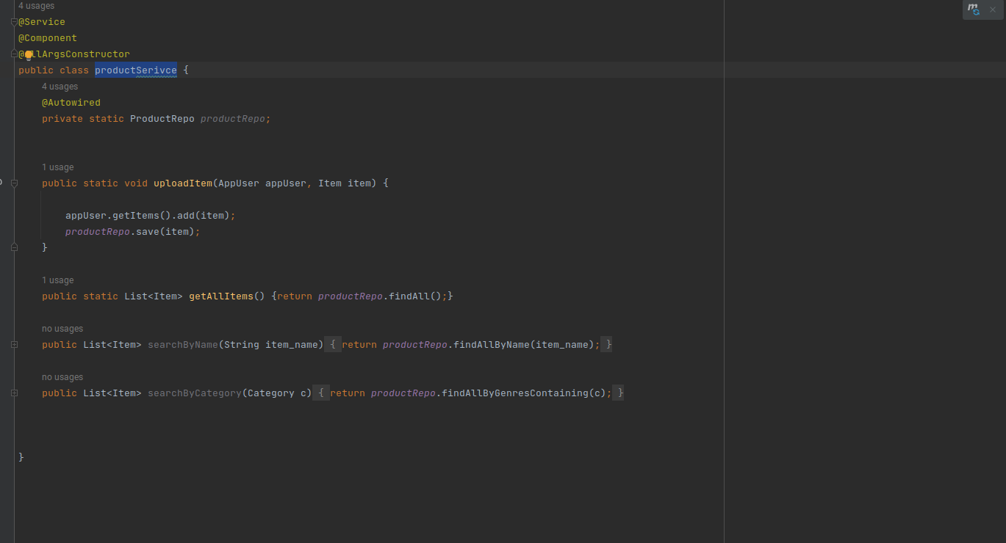
Service

Slide 56
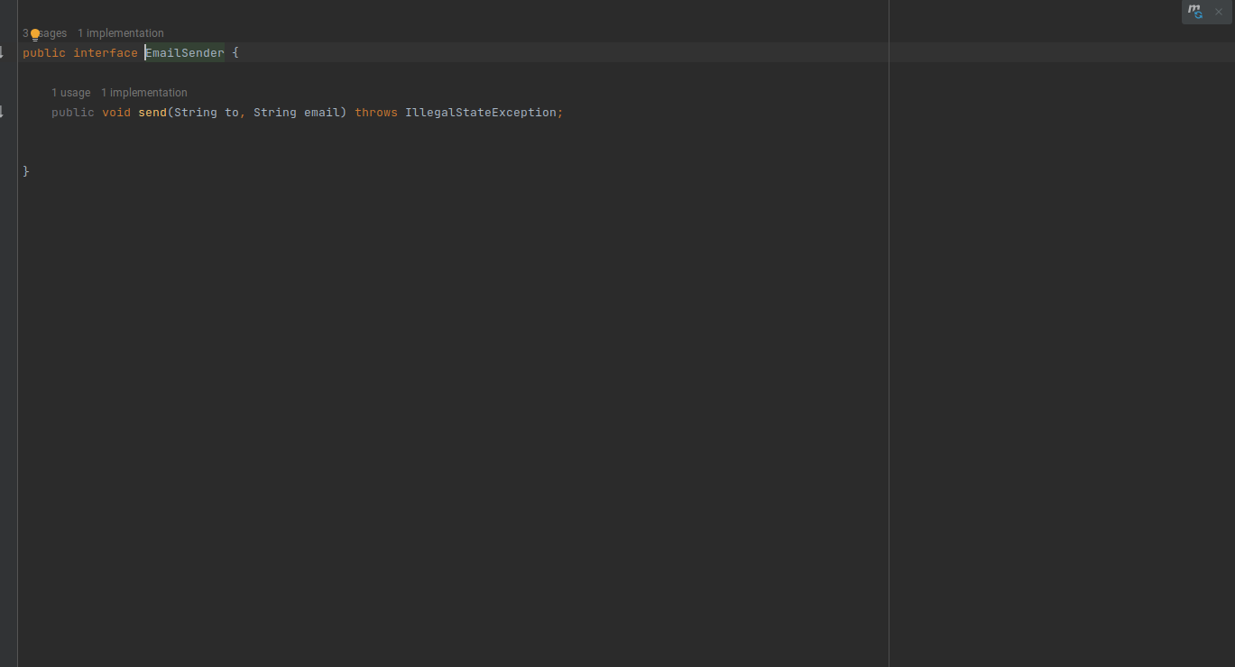
Email Interface

Slide 57
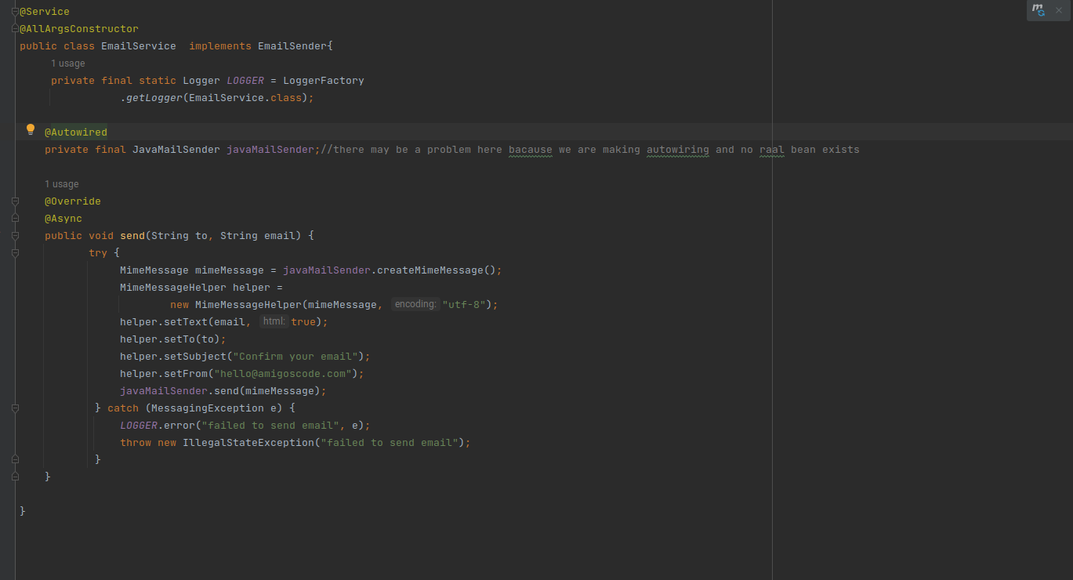
Email Service

Slide 58
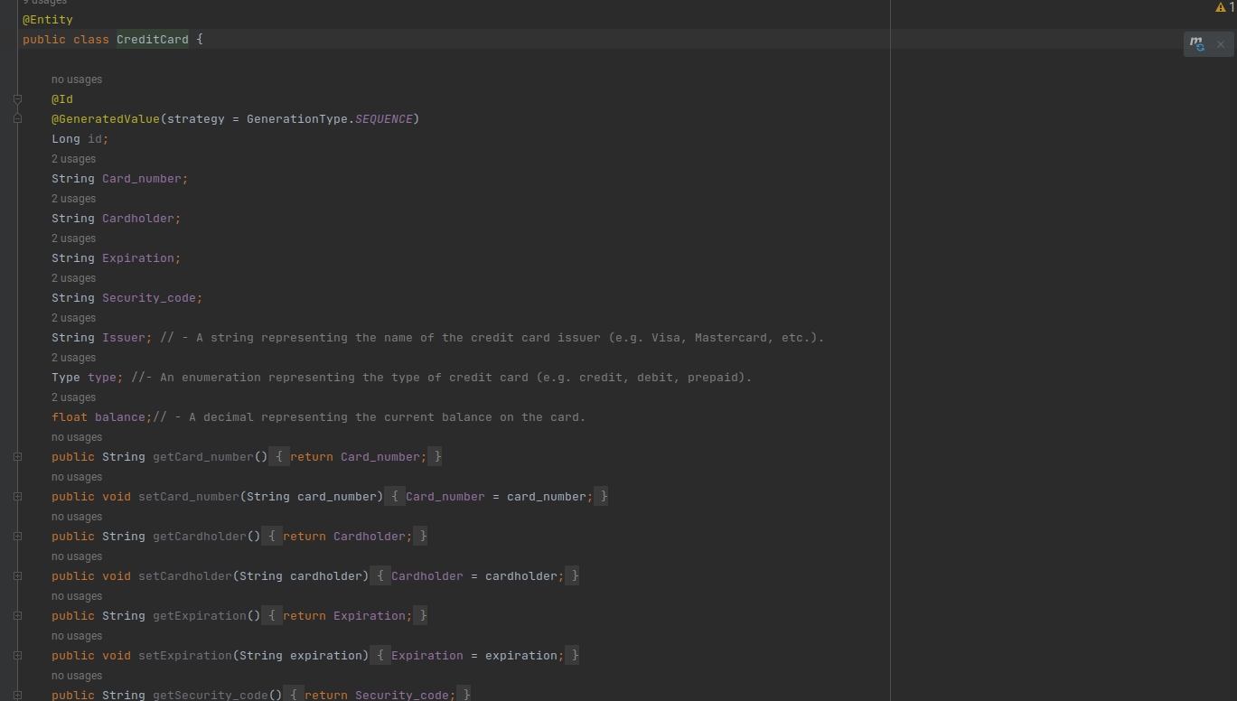
Credit Card Entity

Slide 59
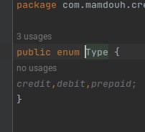
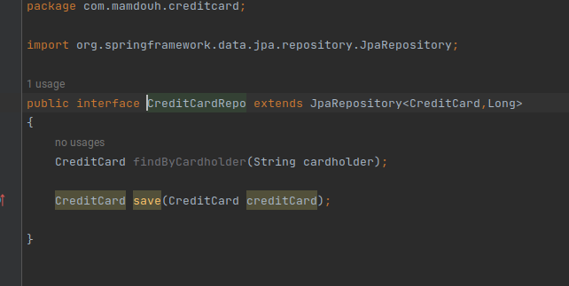
Repo & Type

Slide 60
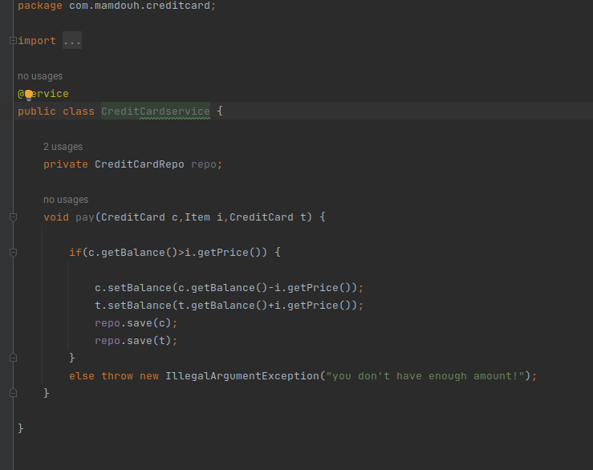
Service

Slide 61
Controller

Slide 62
@GetMapping
@PostMapping
@RequestMapping

Slide 63
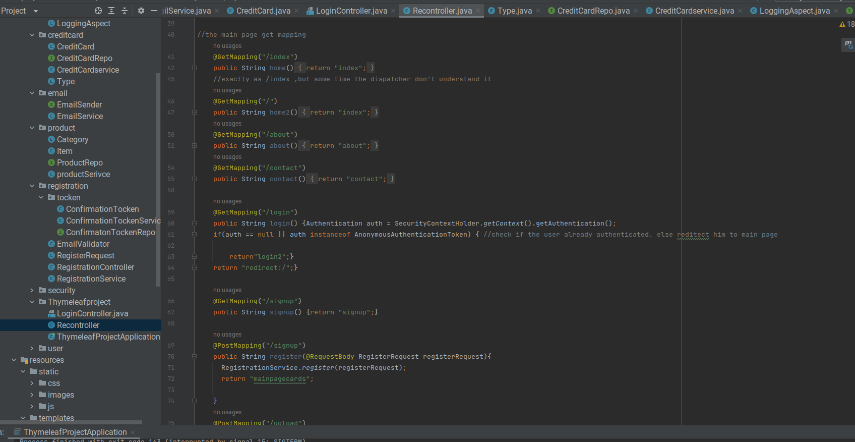

Slide 64
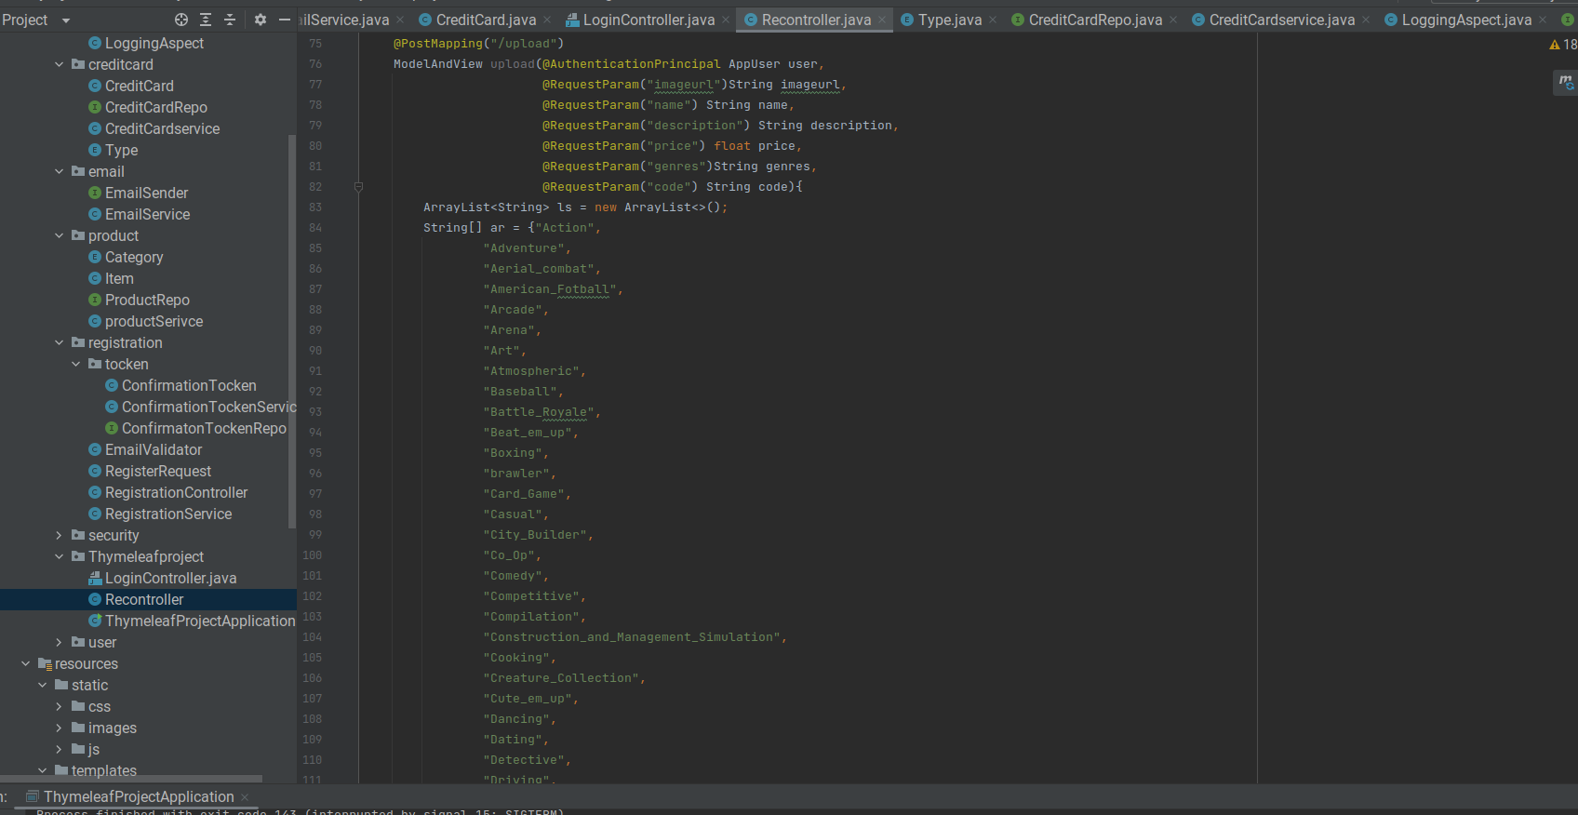

Slide 65
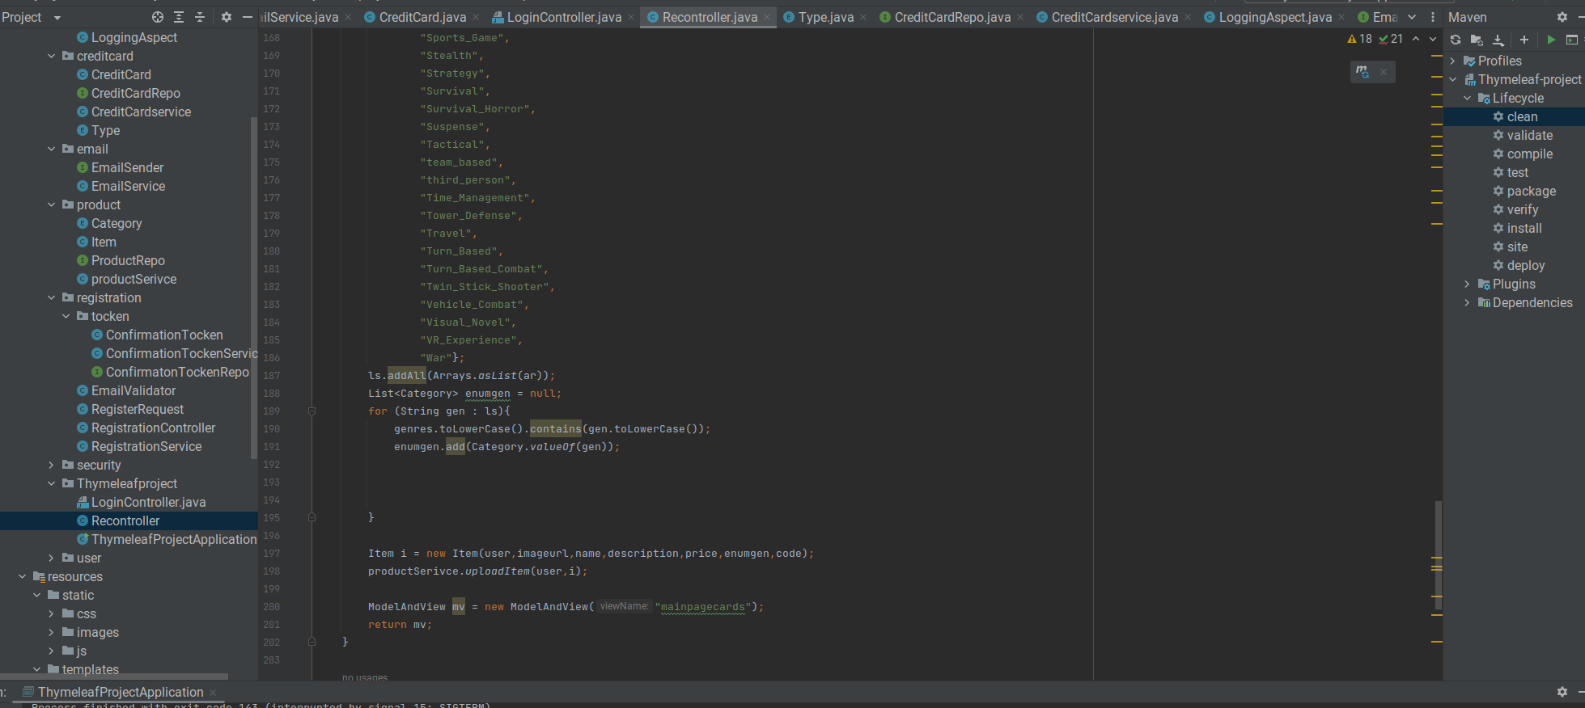

Slide 66

THANK YOU FOR LISTENING

